Slide 1
Correlation and Linear Regression

Slide 2
Relationship between height and shoe size activity
Data to collect: (Using a tape measure)
Write down your height in inches
Write down your shoes size in inches
If you don’t know the exact value, make your best guess
Don’t put any other information
Notes:
While the students are filling out the index cards/post it notes/typing into spreadsheet, the instructor should prepare the axis for the graph on the whiteboard, with shoe size intervals on the x-axis and height on the y-axis. To make the visual illustration of the correlation more prominent, it is better to start the height axis at 40 inches (rather than 0).

Slide 3
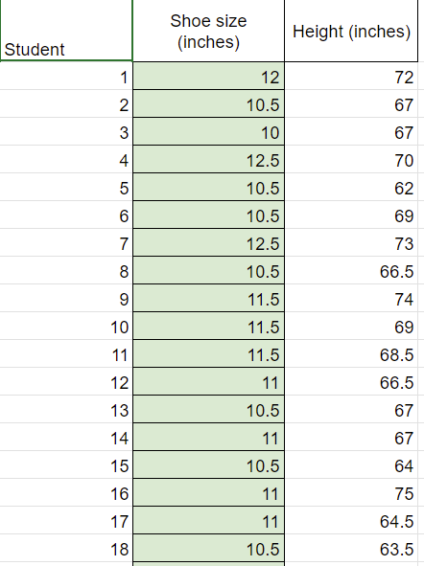
Relationship between height and shoe size activity using Google Sheets
Record your height and shoe size (in inches). Input your data into the shared spreadsheet or report your data to your instructor
Note your height in inches
Note your shoe size in inches
If you don’t know the exact value, make your best guess

Slide 4
Height vs. Shoe Size: Class results
Insert screenshot of a scatter plot of the class data
Display the R² value, line of best fit and its equation if possible

Slide 5
Class discussion: Variables and Correlation
Variable: Observations that can vary
What are our variables in this activity?
Correlation: A relationship or pattern between the values of two variables.
Positive correlation: As x increases, y tends to increase
Negative correlation: As x increases, y tends to decrease
Does there appear to be a correlation between our two variables?
If so, how would you describe it?
What conclusions, if any, can you draw from our graph?

Slide 6
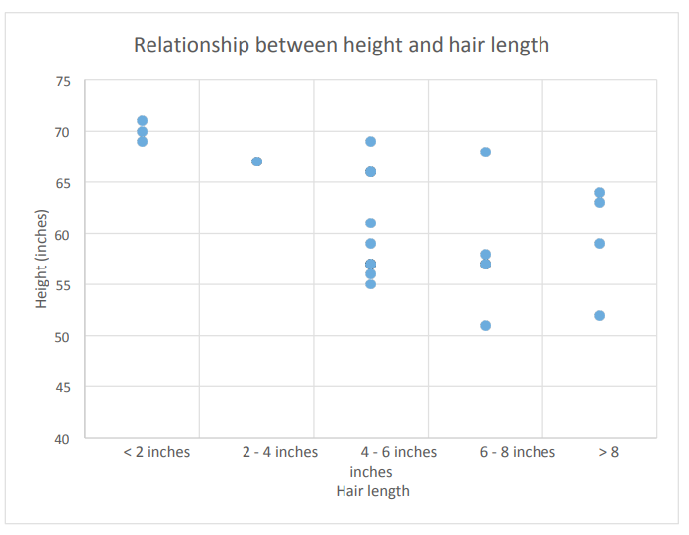
Example: Relationship between height and hair length

Slide 7
Does being being taller cause you to have shorter hair?

Slide 8
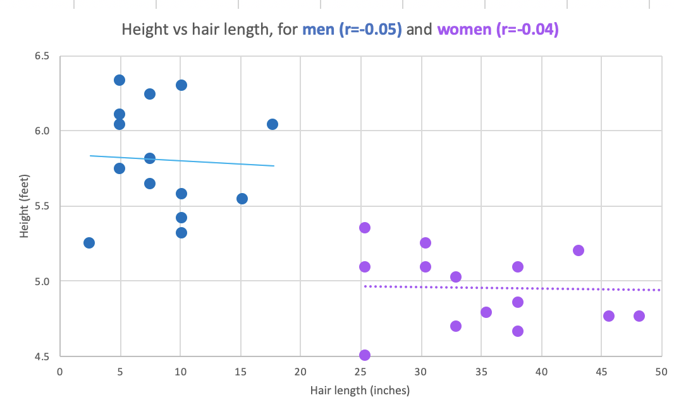
Example: height vs hair length for men and women

